Slide 1

Forecasting Stock market using Sentiment Analysis
Osama Mohamed Abd-Elmoniem Alawadi Elsaeed
2051822264
Supervisors
Sara Nabil & Nisreen Osman

Slide 2
CONTENTS OF THIS TEMPLATE
1 - Introduction:
- Brief on the influence of sentiment in the stock market.
- Objectives: Combine sentiment analysis with technical indicators (Moving Average & RSI).
- Key benefits: Enhanced decision-making reduced emotional bias.
2 - Problem Statement:
- Manual Analysis of vast data is impractical.
- Gap in risk assessment due to lack of sentiment incorporation in traditional metrics.
3 - Amis and Objectives:
- Aim: Develop a sentiment-based risk management tool.
- Objectives: Sentiment model development, integration with MA/RSI, real time dashboard, and model performance evaluation.
4 - Methodology:
- Data Sources: Financial news, social media, stock market APIs.
- Techniques: Text preprocessing, feature extraction, sentiment classification.
- Modeling: Combining NLP methods (FinBERT) with technical analysis tools.
5 - Implementation:
- Pipeline stages: Data collection, cleaning, preprocessing, feature engineering, and training.
- Sentiment scoring and integration with stock price indicators.
6 – Sentiment Analysis Accuracy and Challenges:
- Sentiment analysis accuracy: ~80%.
- integration with logistic regression improved F1-Score to 0.79.
- Challenges: Ambiguous text, real-time scalability.
7 - Conclusion:
- Achievements: Model development, actionable insights, enhanced market predictions.
- Future directions: Multilingual sentiment analysis, real-time scalability, expanded regional analysis.

Slide 3
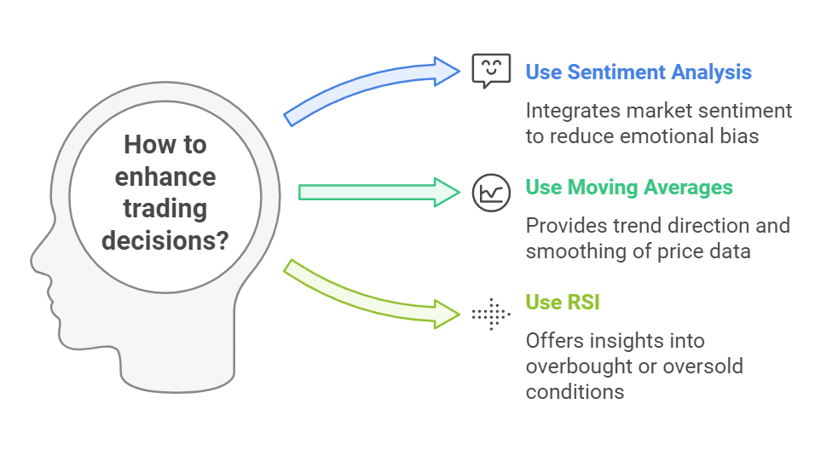
Step 1 :Introduction
In the ever-evolving landscape of stock market trading, understanding the influence of sentiment can significantly impact investment decisions. This document explores the integration of sentiment analysis with traditional technical indicators, specifically Moving Averages and the Relative Strength Index (RSI). By leveraging these tools, traders can enhance their decision-making processes while minimizing emotional biases that often cloud judgment in high-stakes environments.

Slide 4
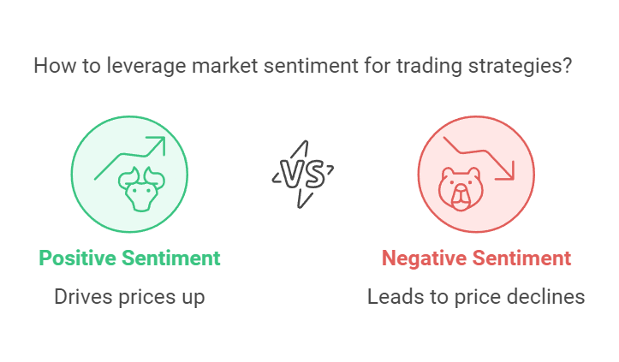
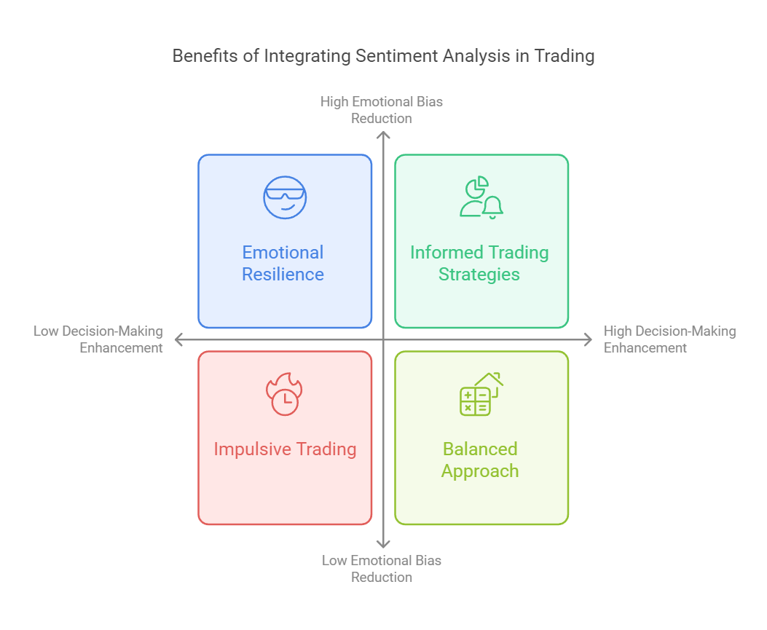
Influence of Sentiment in the Stock Market
Sentiment plays a crucial role in the stock market, as it reflects the collective emotions and attitudes of investors towards specific stocks or the market as a whole. Positive sentiment can drive prices up, while negative sentiment can lead to declines. Understanding market sentiment allows traders to anticipate potential price movements and make informed decisions.
Key Benefits
Enhanced Decision-Making: By incorporating sentiment analysis, traders can complement their technical analysis with insights into market psychology, leading to more informed decisions.
Reduced Emotional Bias: Relying solely on technical indicators can sometimes lead to emotional trading decisions. By using sentiment analysis, traders can ground their strategies in data-driven insights, reducing the likelihood of impulsive actions based on fear or greed.

Slide 5
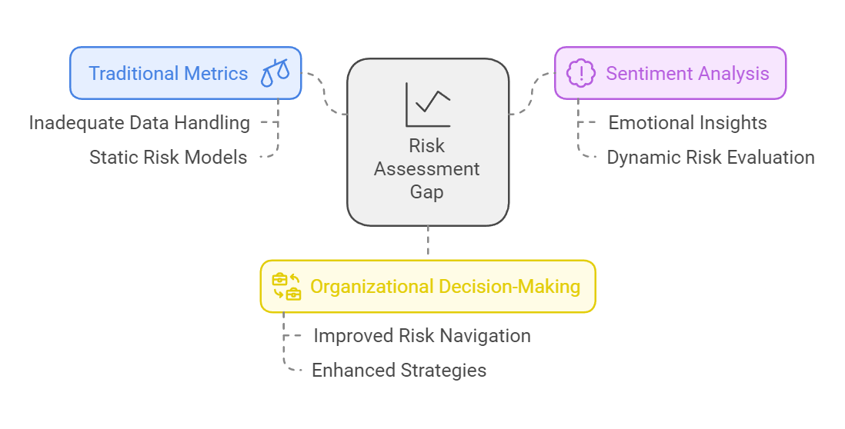
Step 2 :Problem
In today's data-driven world, the sheer volume of information available makes manual analysis impractical. This document explores the significant gap in risk assessment that arises from the traditional metrics used, which often fail to incorporate sentiment analysis. By understanding these limitations, organizations can better navigate risks and enhance their decision-making processes.

Slide 6




Problem definition
The stock market is deeply influenced by human behavior, as investor sentiment often drives trends and price movements. This project presents a sentiment analysis system designed to evaluate financial news, social media posts, and market-related textual data. By leveraging Natural Language Processing (NLP) techniques and machine learning models.
The model is trained on a diverse dataset of financial texts, including news articles, earnings reports, and social media commentary. Utilizing domain-specific lexicons and advanced algorithms, it effectively identifies bullish, bearish, or neutral sentiment, automating an otherwise resource-intensive task
This tool empowers traders, analysts, and investors by delivering real-time sentiment-driven insights, enabling data-driven strategies and enhanced decision-making. It highlights the significant role of AI in analyzing psychological factors, which are essential for navigating the complexities of financial markets

Slide 7


Problem Statement
Effective risk management in the stock market requires analyzing both quantitative metrics and psychological factors like investor sentiment, which significantly influence supply and demand dynamics. Manual analysis of vast data from financial news, social media, and market reports is impractical, leading to missed opportunities
This project addresses this issue by developing a sentiment-based risk management tool that integrates sentiment analysis with MA and RSI, providing investors with a holistic view of market conditions to enhance decision-making and minimize risks in volatile markets
While technical indicators such as Moving Averages (MA) and Relative Strength Index (RSI) are widely used, they fail to incorporate sentiment analysis, creating a gap in comprehensive market risk assessment

Slide 8


Step 3 :Aims And Objectives
Aims
Develop a risk management tool for the stock market combining sentiment analysis with technical indicators (MA, RSI) to enhance decision-making and minimize investment risks

Slide 9
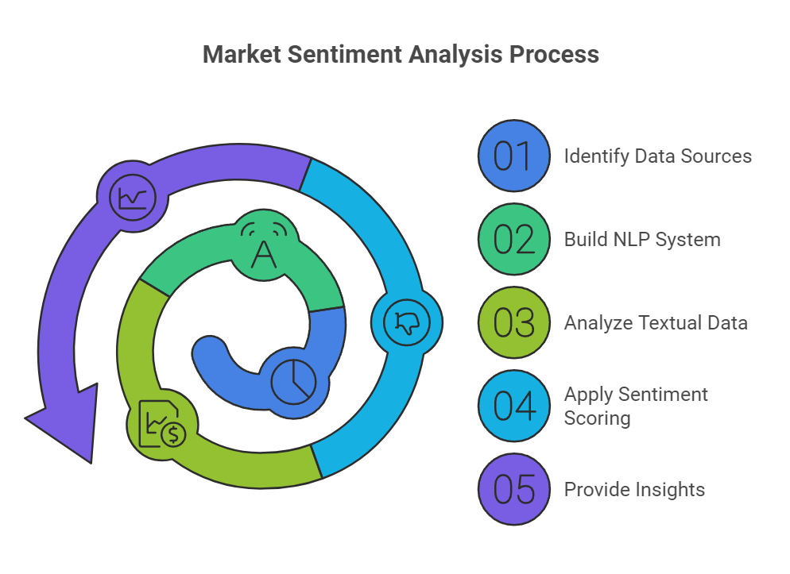
Objectives
1- Develop sentiment analysis model
The first step involves building a machine learning-based Natural Language Processing (NLP) system. This system will analyze and quantify market sentiment derived from financial news, social media posts, and other relevant textual data sources. By leveraging techniques such as sentiment scoring and natural language understanding, the model will provide insights into how market sentiment fluctuates over time.

Slide 10
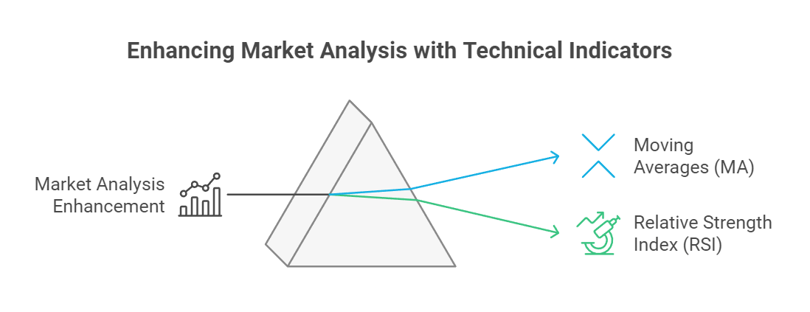
2- Integrate Technical Indicators
To complement the sentiment analysis, we will incorporate technical indicators such as Moving Averages (MA) and the Relative Strength Index (RSI). These indicators will help assess price trends and market momentum, providing a quantitative basis for understanding market movements. The integration of these indicators will allow for a more nuanced analysis of market conditions.

Slide 11
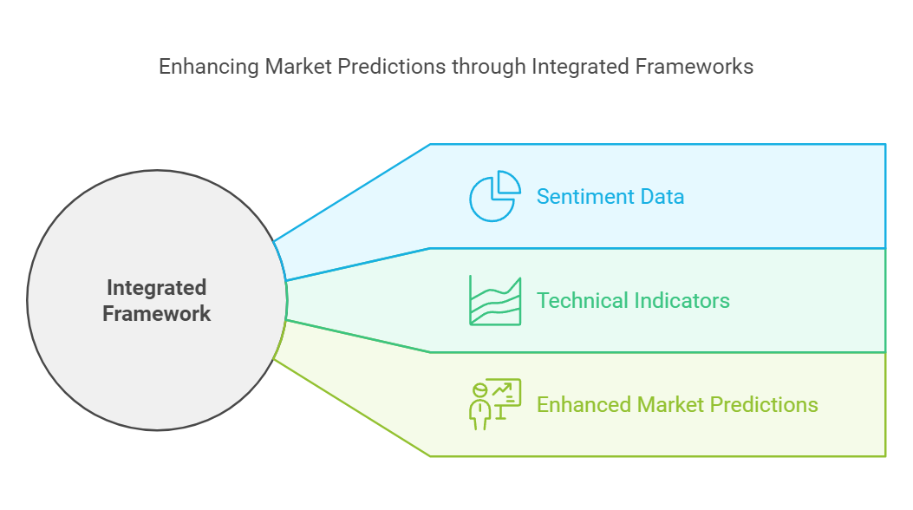
3- Combine Sentiment and Technical Analysis
An integrated framework will be developed to fuse sentiment data with traditional technical indicators. This combination aims to provide a more holistic view of market dynamics, enabling investors to make informed decisions based on both qualitative sentiment and quantitative technical analysis. The synergy between these two approaches will enhance the overall accuracy of market predictions.

Slide 12
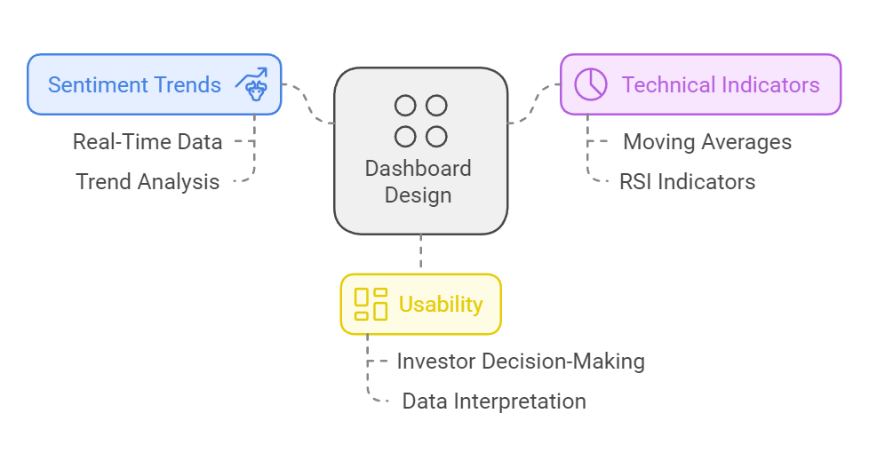
4- Design a User-Friendly Dashboard
To facilitate user interaction with the analysis tool, a visual interface will be created. This dashboard will allow users to monitor sentiment trends, Moving Averages, and RSI indicators for various stocks, including high-profile companies like Tesla and Google, in real-time. The design will prioritize usability, ensuring that investors can easily interpret the data and make timely decisions.

Slide 13
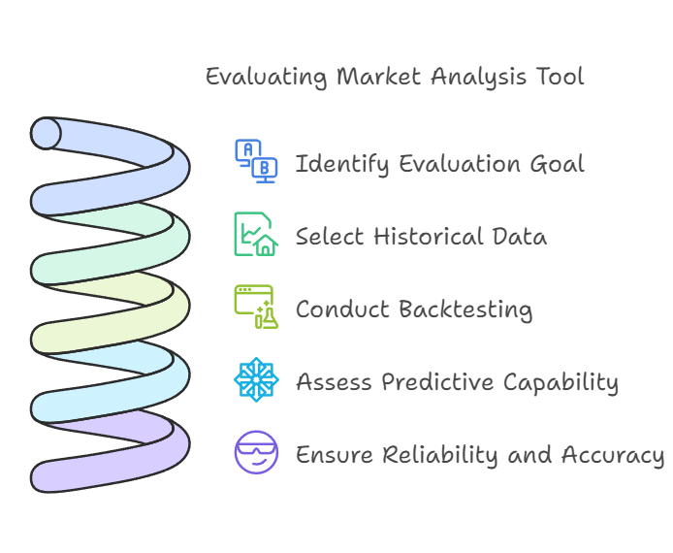
5- Evaluate Model Accuracy and Performance
The effectiveness of the tool will be tested using historical market data. We will assess its predictive capability for identifying market risks and opportunities. This evaluation will involve backtesting the model against past market conditions to ensure reliability and accuracy in its predictions.

Slide 14
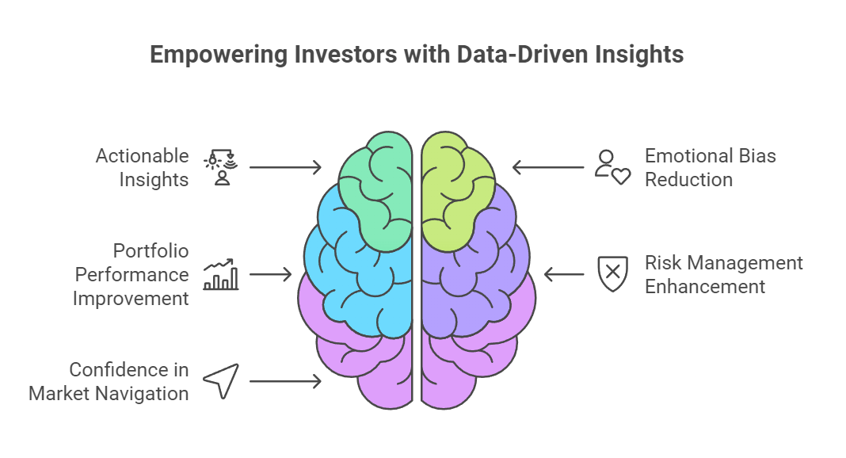
6- Enhance Risk Management Strategies
Finally, the tool will provide actionable insights that assist investors in making data-driven decisions. By reducing emotional bias and improving portfolio performance, the system aims to enhance risk management strategies. The insights generated will empower investors to navigate market fluctuations with greater confidence.

Slide 15
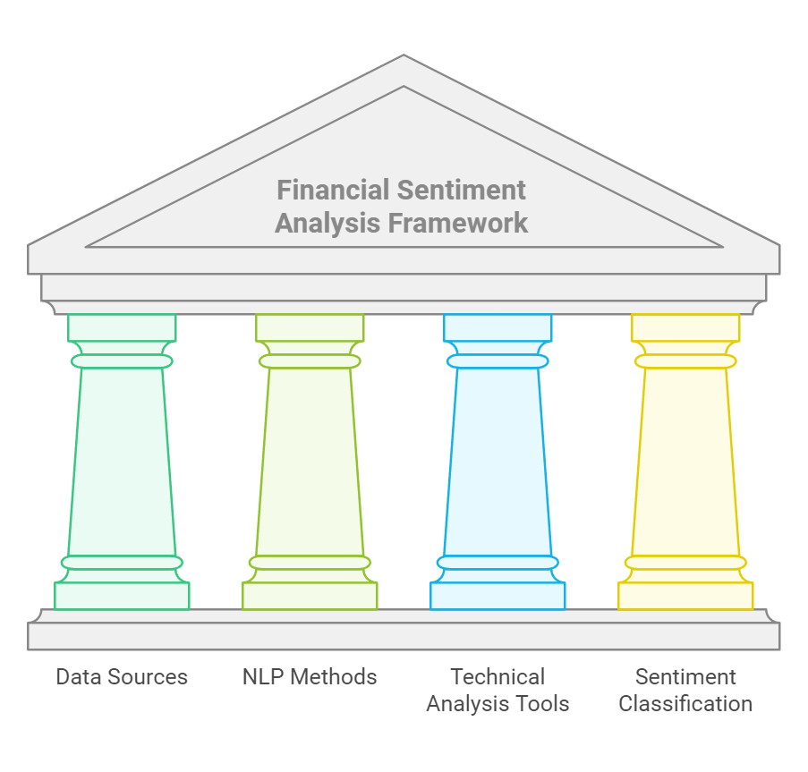
Step 4 :Methodology
Outlines the methodology employed for conducting financial sentiment analysis using various data sources and techniques. The approach integrates natural language processing (NLP) methods with technical analysis tools to derive insights from financial news, social media, and stock market data. The aim is to create a robust framework that can effectively classify sentiment and inform investment decisions.

Slide 16
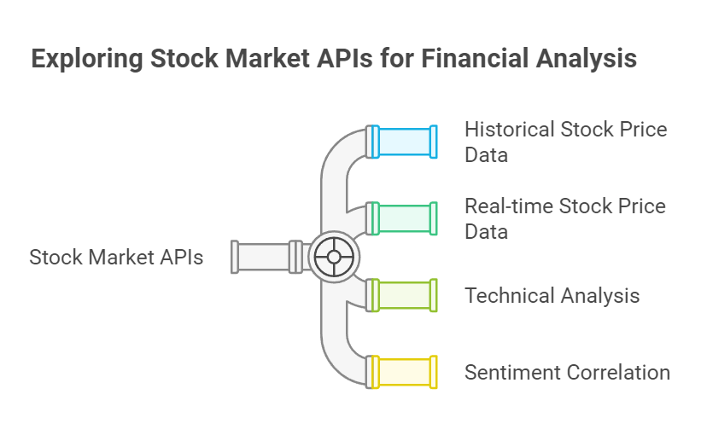
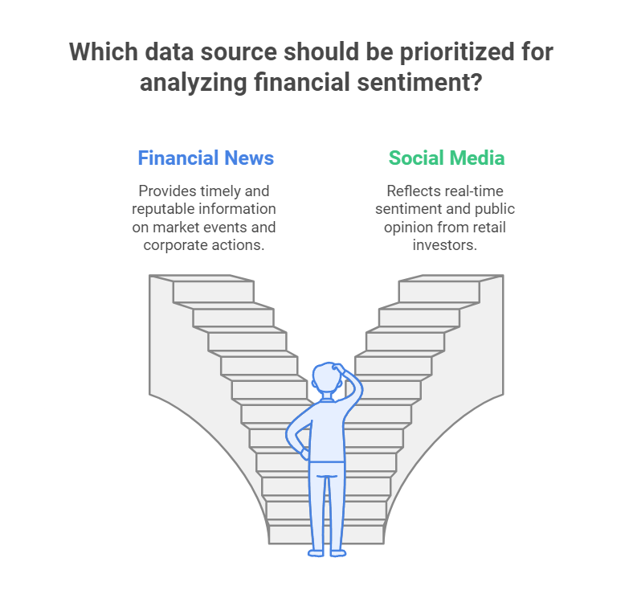
1- Data Sources
Stock Market APIs: APIs such as Alpha Vantage or Yahoo Finance offer historical and real-time stock price data, which can be used for technical analysis and to correlate sentiment with market performance.
Financial News: Articles, reports, and press releases from reputable financial news outlets provide timely information on market events and corporate actions that can influence stock prices.
Social Media: Platforms like Twitter and Reddit serve as valuable sources of real-time sentiment from retail investors and market participants, reflecting public opinion and potential market movements.

Slide 17
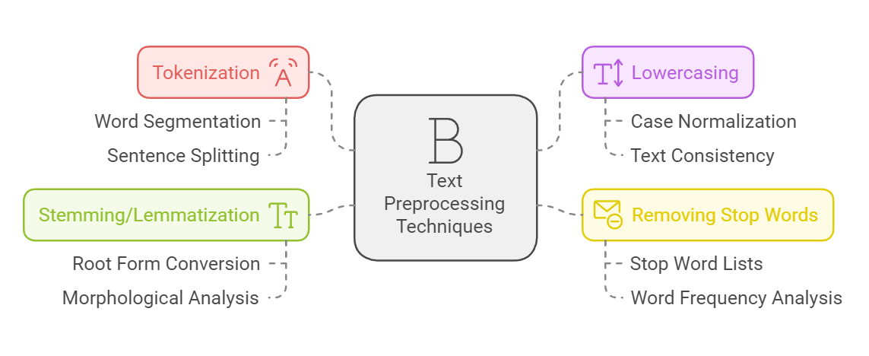
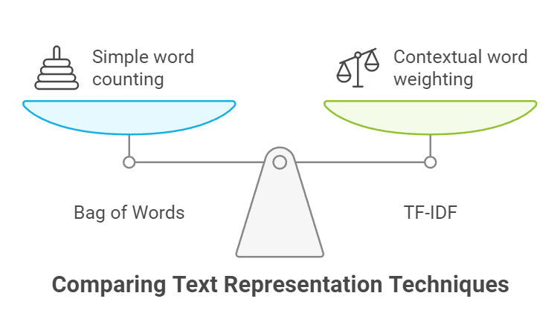
2- Techniques
Text Preprocessing: Text preprocessing is a crucial step in preparing raw text data for analysis. this includes:
Tokenization: Splitting text into individual words or tokens.
Lowercasing: Converting all text to lowercase to ensure uniformity.
Removing Stop Words: Filtering out common words that do not contribute to sentiment (e.g., "the", "is", "and").
Stemming/Lemmatization: Reducing words to their base or root form to standardize variations.
Feature Extraction: Feature extraction involves transforming processed text into a format suitable for modeling. Techniques include:
Bag of Words (BoW): Representing text data as a matrix of word counts.
Term Frequency-Inverse Document Frequency (TF-IDF): Weighing words based on their frequency in a document relative to their frequency across multiple documents.
Word Embeddings: Utilizing pre-trained models like Word2Vec or GloVe to capture semantic relationships between words.

Slide 18
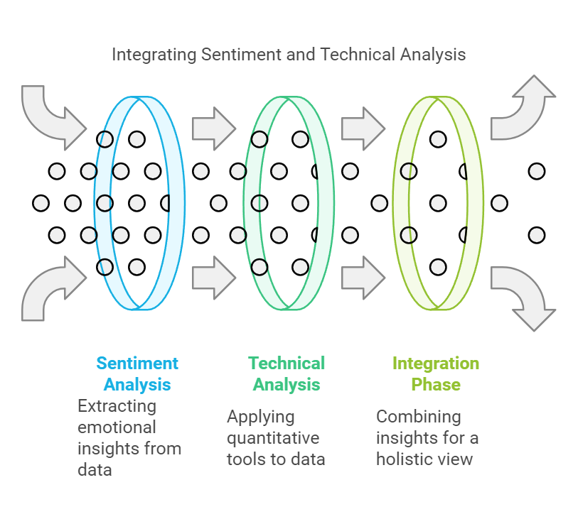
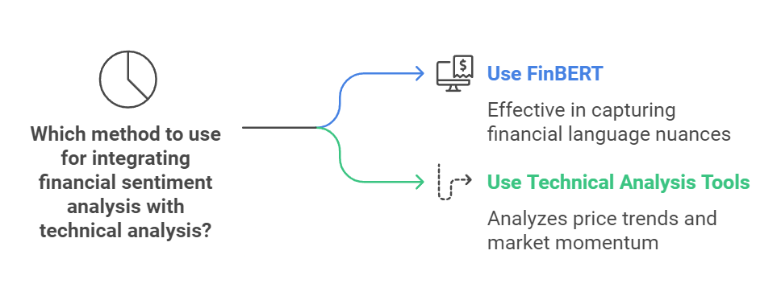
3- Modeling
The final modeling phase involves integrating the outputs of sentiment analysis with technical analysis tools.
FinBERT: A specialized BERT model fine-tuned for financial sentiment analysis, which can effectively capture the nuances of financial language.
Technical Analysis Tools: Indicators such as Moving Averages, Relative Strength Index (RSI), and Bollinger Bands can be employed to analyze price trends and market momentum.

Slide 19
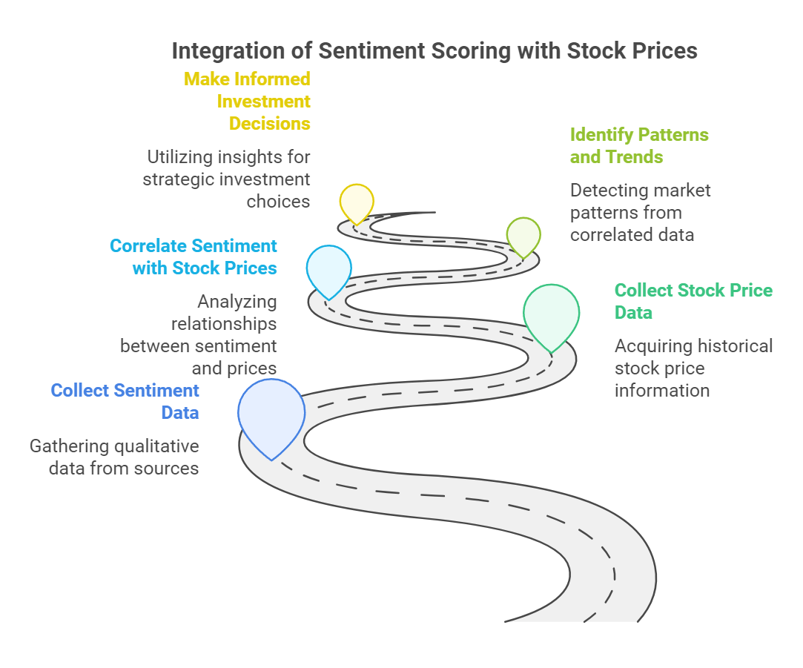
Step 5 :Implementation
An essential aspect of this pipeline is the integration of sentiment scoring with stock price indicators. By correlating sentiment scores with historical stock price data, analysts can identify patterns and trends that may indicate potential price movements. This integration allows for a more comprehensive analysis, enabling investors to make informed decisions based on both quantitative and qualitative data.

Slide 20
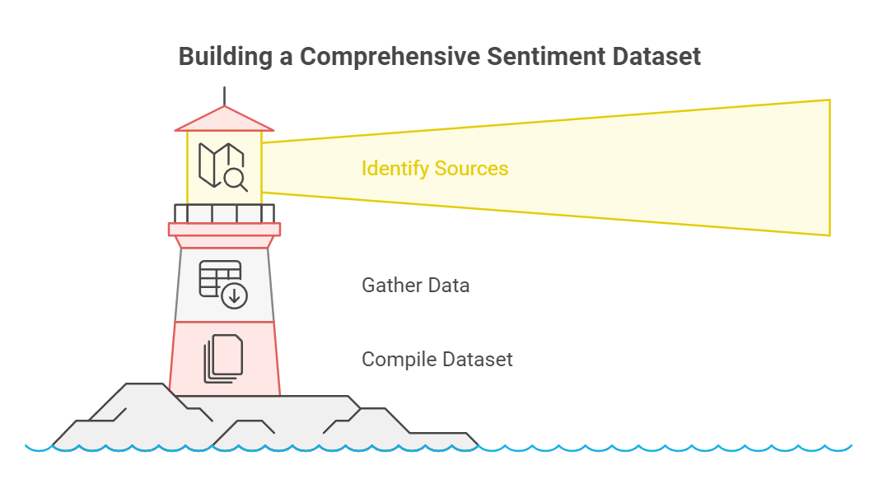
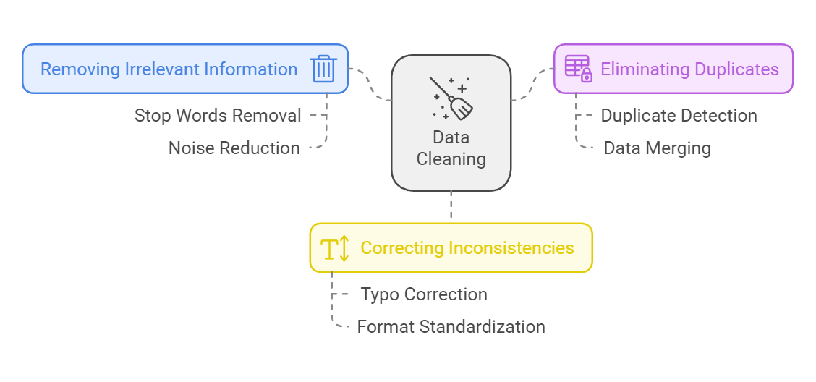
1- Data Collection
The first step in the pipeline is data collection, where relevant data sources are identified and gathered. This may include social media posts, news articles, financial reports, and other textual data that could influence stock prices. The goal is to compile a comprehensive dataset that reflects public sentiment regarding specific stocks or the market as a whole.
2- Data Cleaning
Once the data is collected, the next stage is data cleaning. This involves removing any irrelevant information, duplicates, and inconsistencies within the dataset. Techniques such as removing stop words, correcting typos, and standardizing formats are employed to ensure that the data is clean and ready for analysis. This step is critical as it directly impacts the quality of the sentiment analysis.

Slide 21
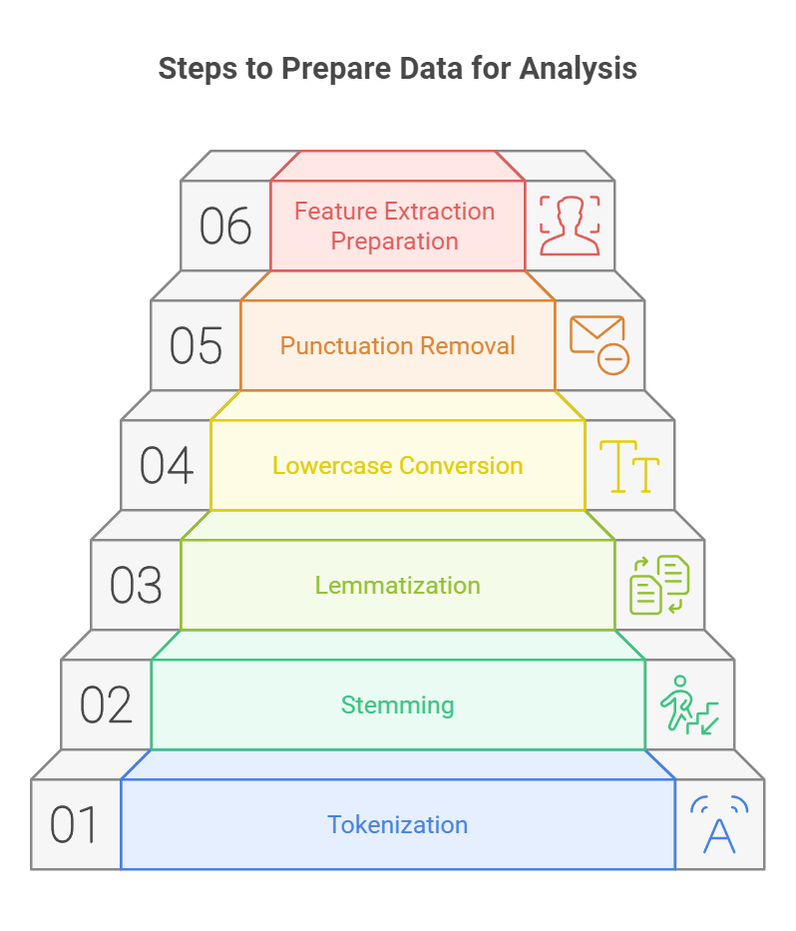
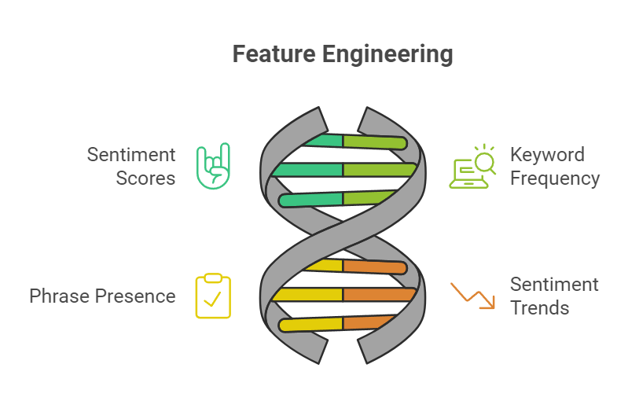
3- Preprocessing
Preprocessing is the stage where the cleaned data is transformed into a format suitable for analysis. This may involve tokenization, stemming, and lemmatization, which break down the text into manageable pieces and reduce words to their base forms. Additionally, converting text to lowercase and removing punctuation helps in standardizing the data. The goal is to prepare the data for effective feature extraction.
4- Feature Engineering
Feature engineering is a vital stage where meaningful features are extracted from the preprocessed data. This may include generating sentiment scores using natural language processing (NLP) techniques, such as sentiment analysis algorithms or lexicon-based approaches. Other features may include the frequency of specific keywords, the presence of certain phrases, or even the sentiment trends over time. These features will serve as inputs for the training phase.

Slide 22
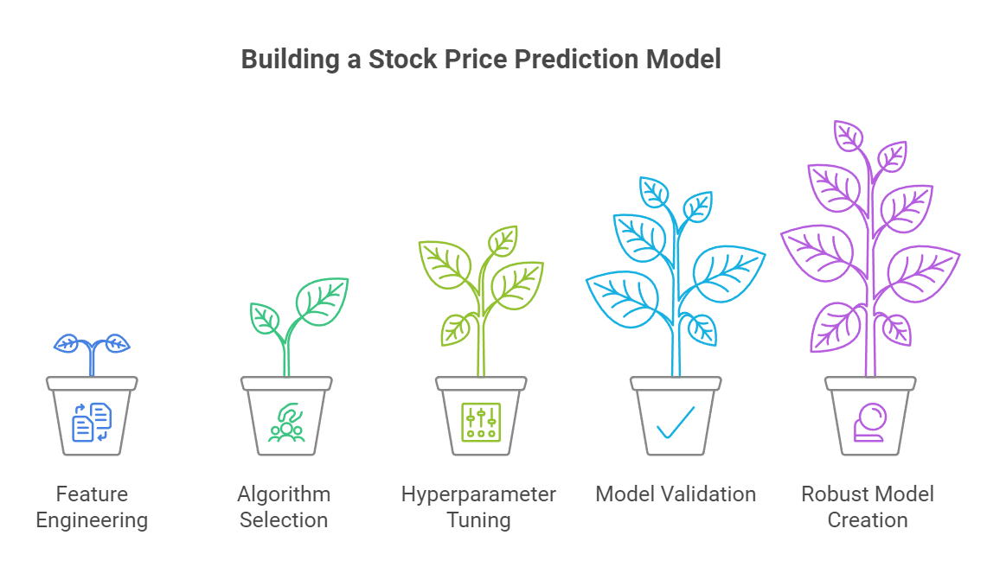
5- Training
The final stage of the pipeline is training, where machine learning models are developed using the engineered features. The models are trained to predict stock price movements based on the sentiment scores and other relevant indicators. This stage may involve selecting appropriate algorithms, tuning hyperparameters, and validating the model's performance using historical data. The ultimate goal is to create a robust model that can accurately forecast stock price changes based on sentiment analysis.

Slide 23
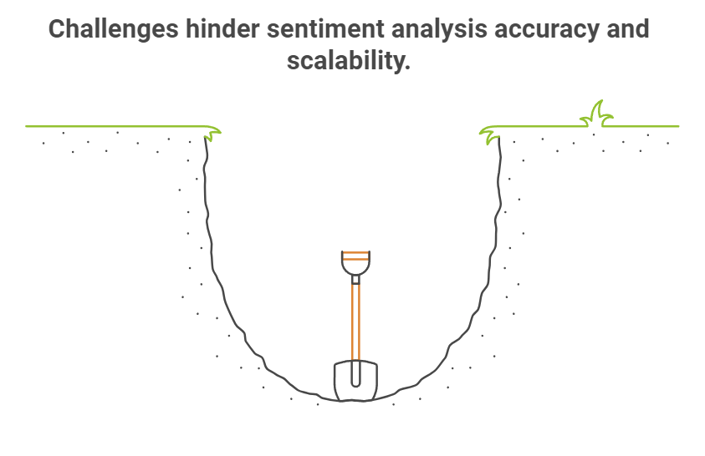
Step 6 :Sentiment Analysis Accuracy and Challenges
Overview of the current state of sentiment analysis accuracy, highlighting key metrics and challenges faced in the field. With an accuracy rate of approximately 80%, sentiment analysis has shown promising results, particularly when integrated with logistic regression, which has improved the F1-Score to 0.79. However, the implementation of sentiment analysis is not without its challenges, including the handling of ambiguous text and the need for real-time scalability.

Slide 24
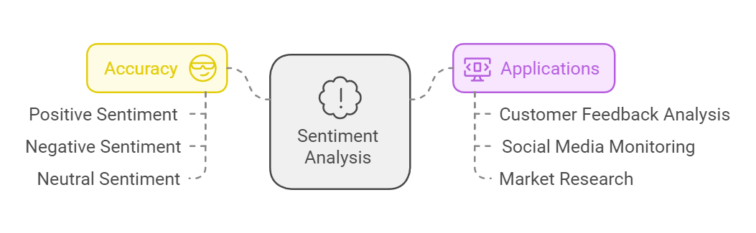
1- Sentiment Analysis Accuracy
Sentiment analysis has reached an accuracy of around 80%, indicating a strong ability to classify text as positive, negative, or neutral. This level of accuracy is significant for various applications, including customer feedback analysis, social media monitoring, and market research.

Slide 25
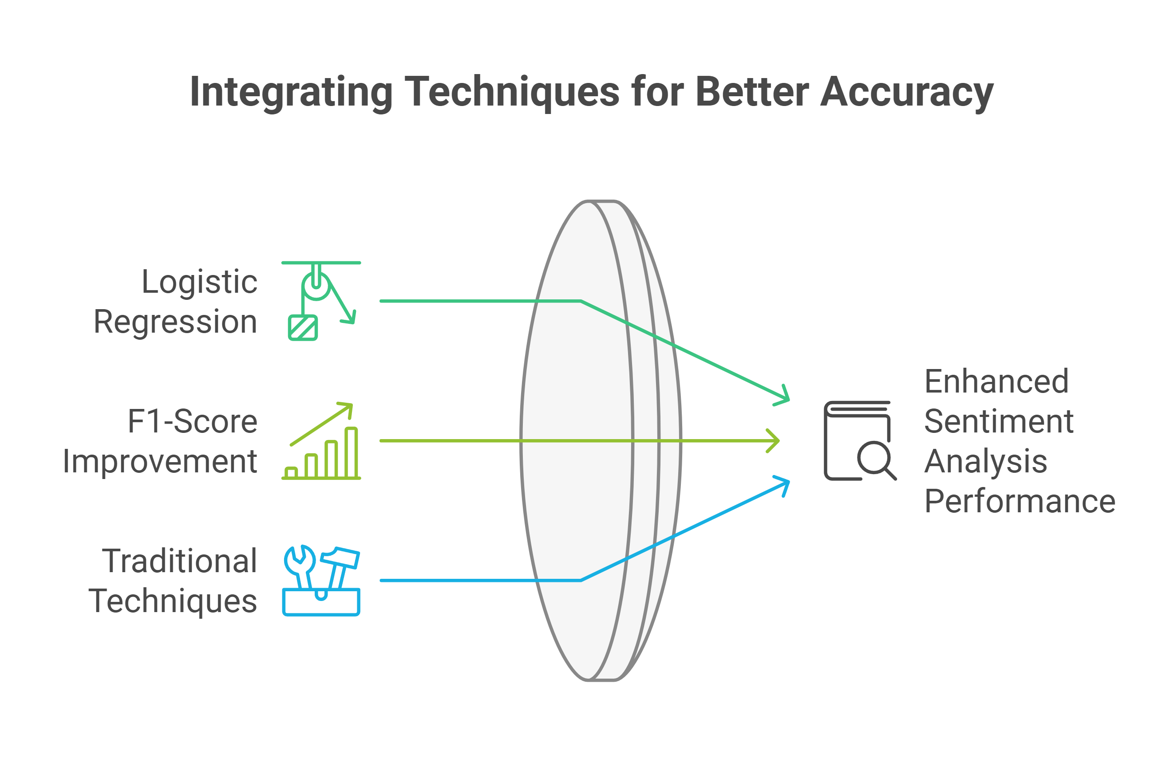
2 – Integration With Logistic Regression
The integration of logistic regression into sentiment analysis models has proven beneficial. By applying this statistical method, the F1-Score—a measure of a model's accuracy that considers both precision and recall—has improved to 0.79. This enhancement demonstrates the effectiveness of combining traditional machine learning techniques with sentiment analysis to achieve better performance metrics.

Slide 26
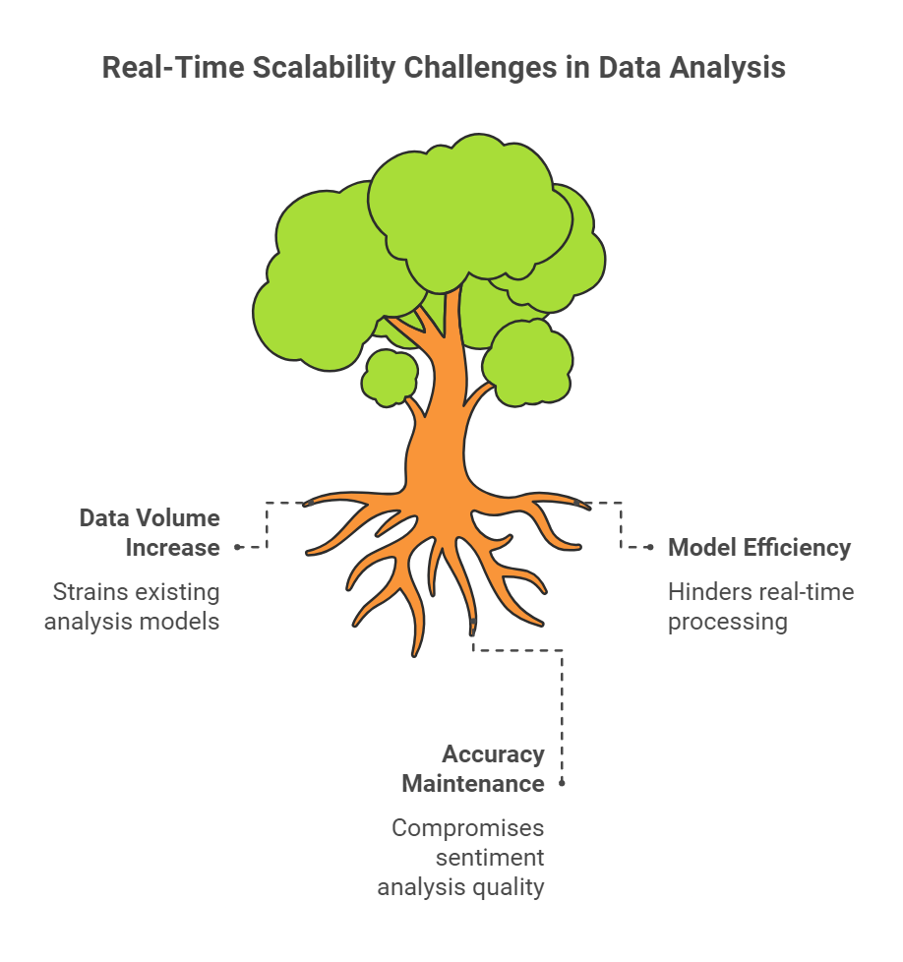
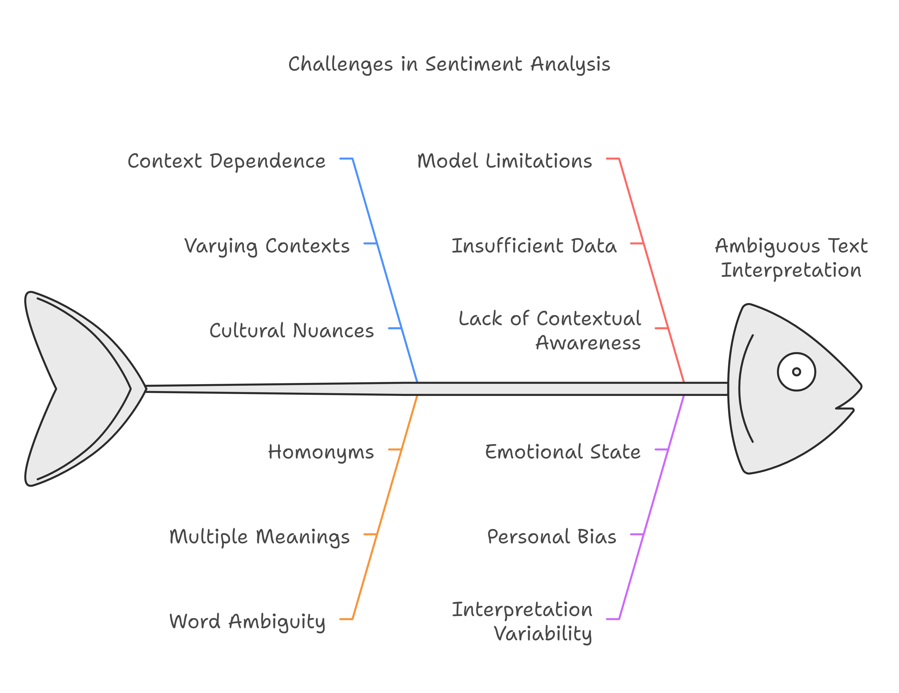
3 – Challenges in Sentiment analysis
Real-Time Scalability: Another challenge is the need for real-time scalability. As the volume of data increases, particularly in social media and customer interactions, the ability to analyze sentiment in real-time becomes crucial. Ensuring that models can handle large datasets efficiently while maintaining accuracy is a significant hurdle.
Ambiguous Text: One of the primary challenges is dealing with ambiguous or context-dependent text. Sentiment can vary significantly based on the context in which words are used, making it difficult for models to accurately interpret the intended sentiment.

Slide 27
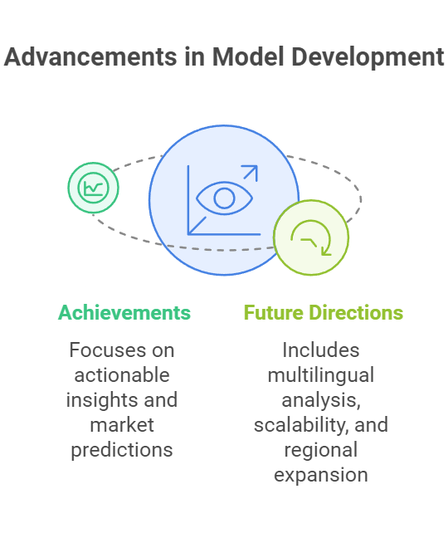
Step 7 :Conclusion
This document outlines the significant achievements in model development, focusing on actionable insights and enhanced market predictions. It also discusses future directions that include multilingual sentiment analysis, real-time scalability, and expanded regional analysis. These advancements are crucial for improving the effectiveness and reach of predictive models in various markets.

Slide 28
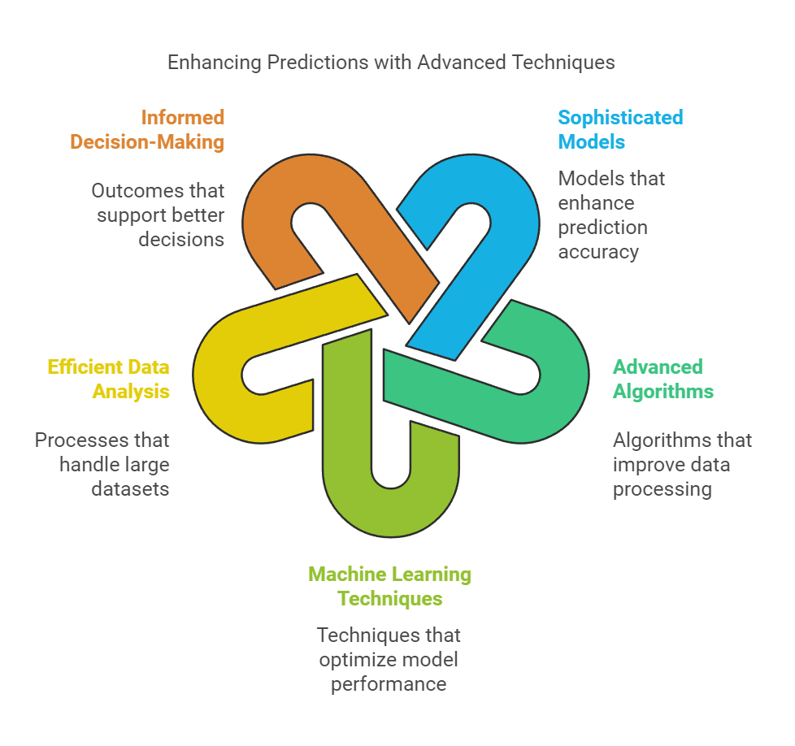
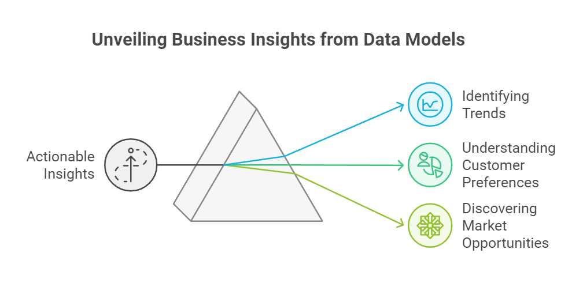
1- Achievement
Model Development: The development of sophisticated models has led to improved accuracy and reliability in predictions. By leveraging advanced algorithms and machine learning techniques, we have created models that can analyze vast datasets efficiently, resulting in more informed decision-making processes.
Actionable Insights: Through the application of these models, we have generated actionable insights that empower businesses to make strategic decisions. These insights are derived from comprehensive data analysis, allowing organizations to identify trends, customer preferences, and potential market opportunities.

Slide 29
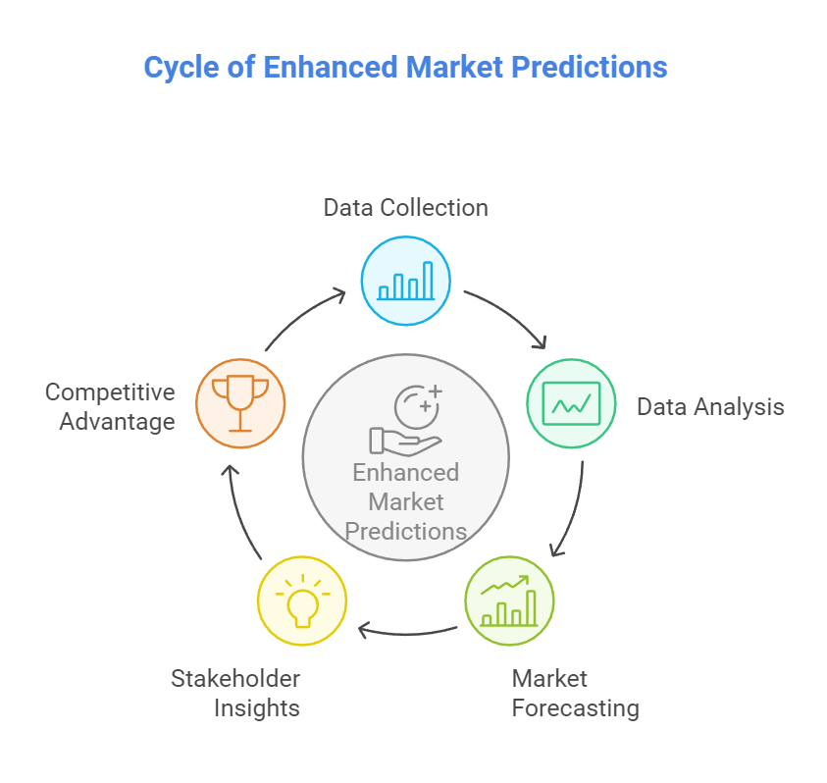
Enhanced Market Predictions: Our enhanced market predictions have provided stakeholders with a clearer understanding of market dynamics. By incorporating various data sources and analytical methods, we have been able to forecast market movements with greater precision, enabling businesses to stay ahead of the competition.

Slide 30
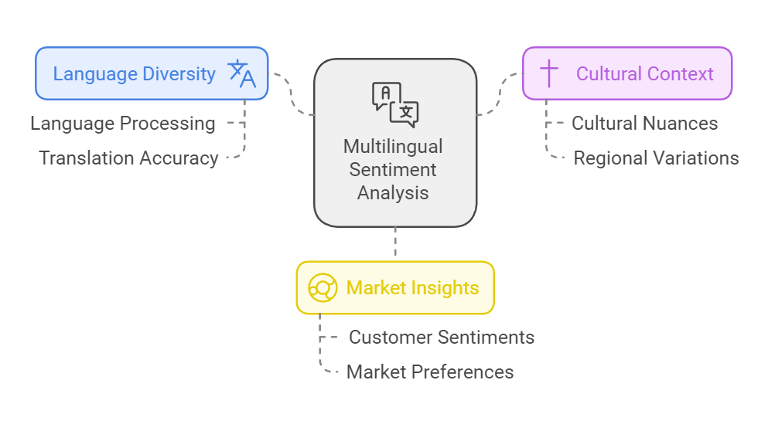
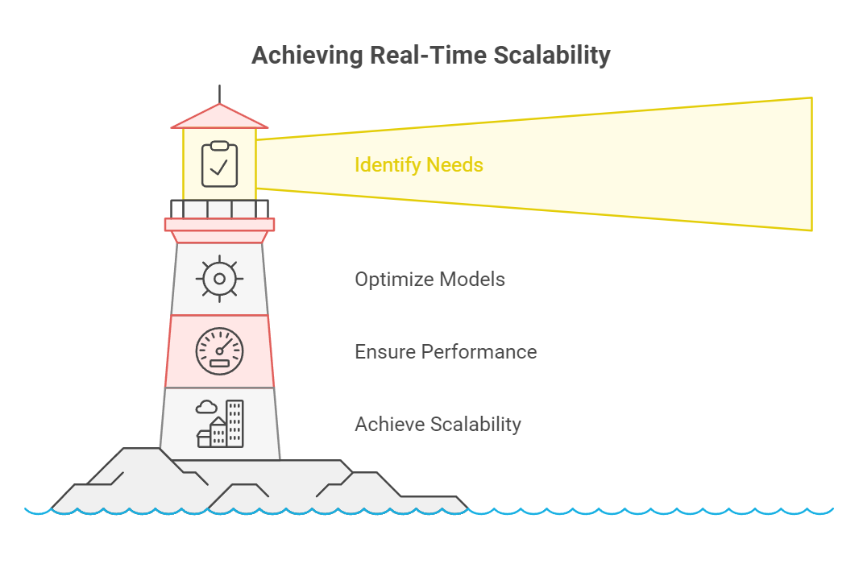
2- Future Directions
Multilingual Sentiment Analysis: One of the key future directions is the development of multilingual sentiment analysis capabilities. This will allow us to analyze customer sentiments across different languages and cultures, providing a more holistic view of market perceptions and preferences.
Real-Time Scalability: Another important focus will be on achieving real-time scalability. As markets evolve rapidly, the ability to process and analyze data in real-time will be essential for timely decision-making. This will involve optimizing our models to handle large volumes of data without compromising performance.

Slide 31
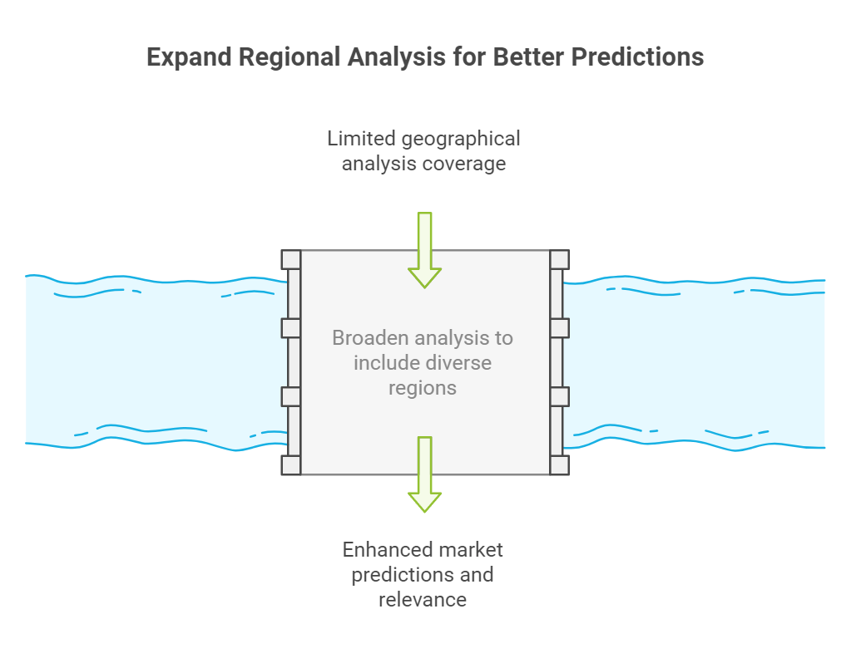
Expanded Regional Analysis: Lastly, we aim to expand our regional analysis to cover a broader range of geographical areas. By understanding regional differences in market behavior, we can tailor our models to better serve diverse markets and enhance the relevance of our predictions.

Slide 32

Thanks

